Slide 1

FAIR DO Issues
Peter Wittenburg
Max Planck Computing & Data Facility
CC BY-SA 4.0

Slide 2
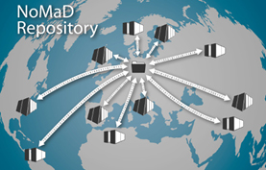
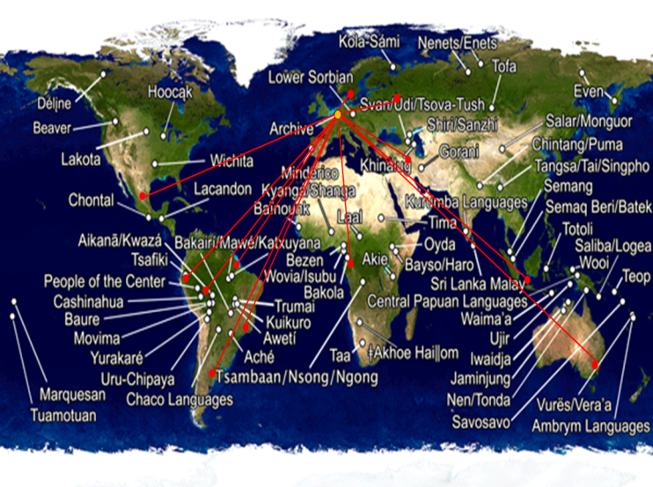
My Background: Data Labs
many questions possible now
can we find new types of categorisations in the endless space of compound materials and increase the speed in finding appropriate materials?
can we better understand the evolution of languages and compensatory strategies in language systems?
much more of course
re-occuring patterns
definition of a common „data core“
global data aggregation and integration
application of ML etc. methods to look for hidden patterns in data
extraction of knowledge
formalising knowledge (nano publications)?
Material Science
Humanities

Slide 3
Better Practices are required
80% of time in data projects wasted with „wrangling“
>60% of data projects fail
80% of our data is „dark data“ and will be
lost in 20 years (Heidorn)
many possible data projects cannot be done
many researchers are excluded
a whole department is needed to do DIS
we are using the web – but it‘s ephemeral ...
... and Clouds are just a big pot

Slide 4
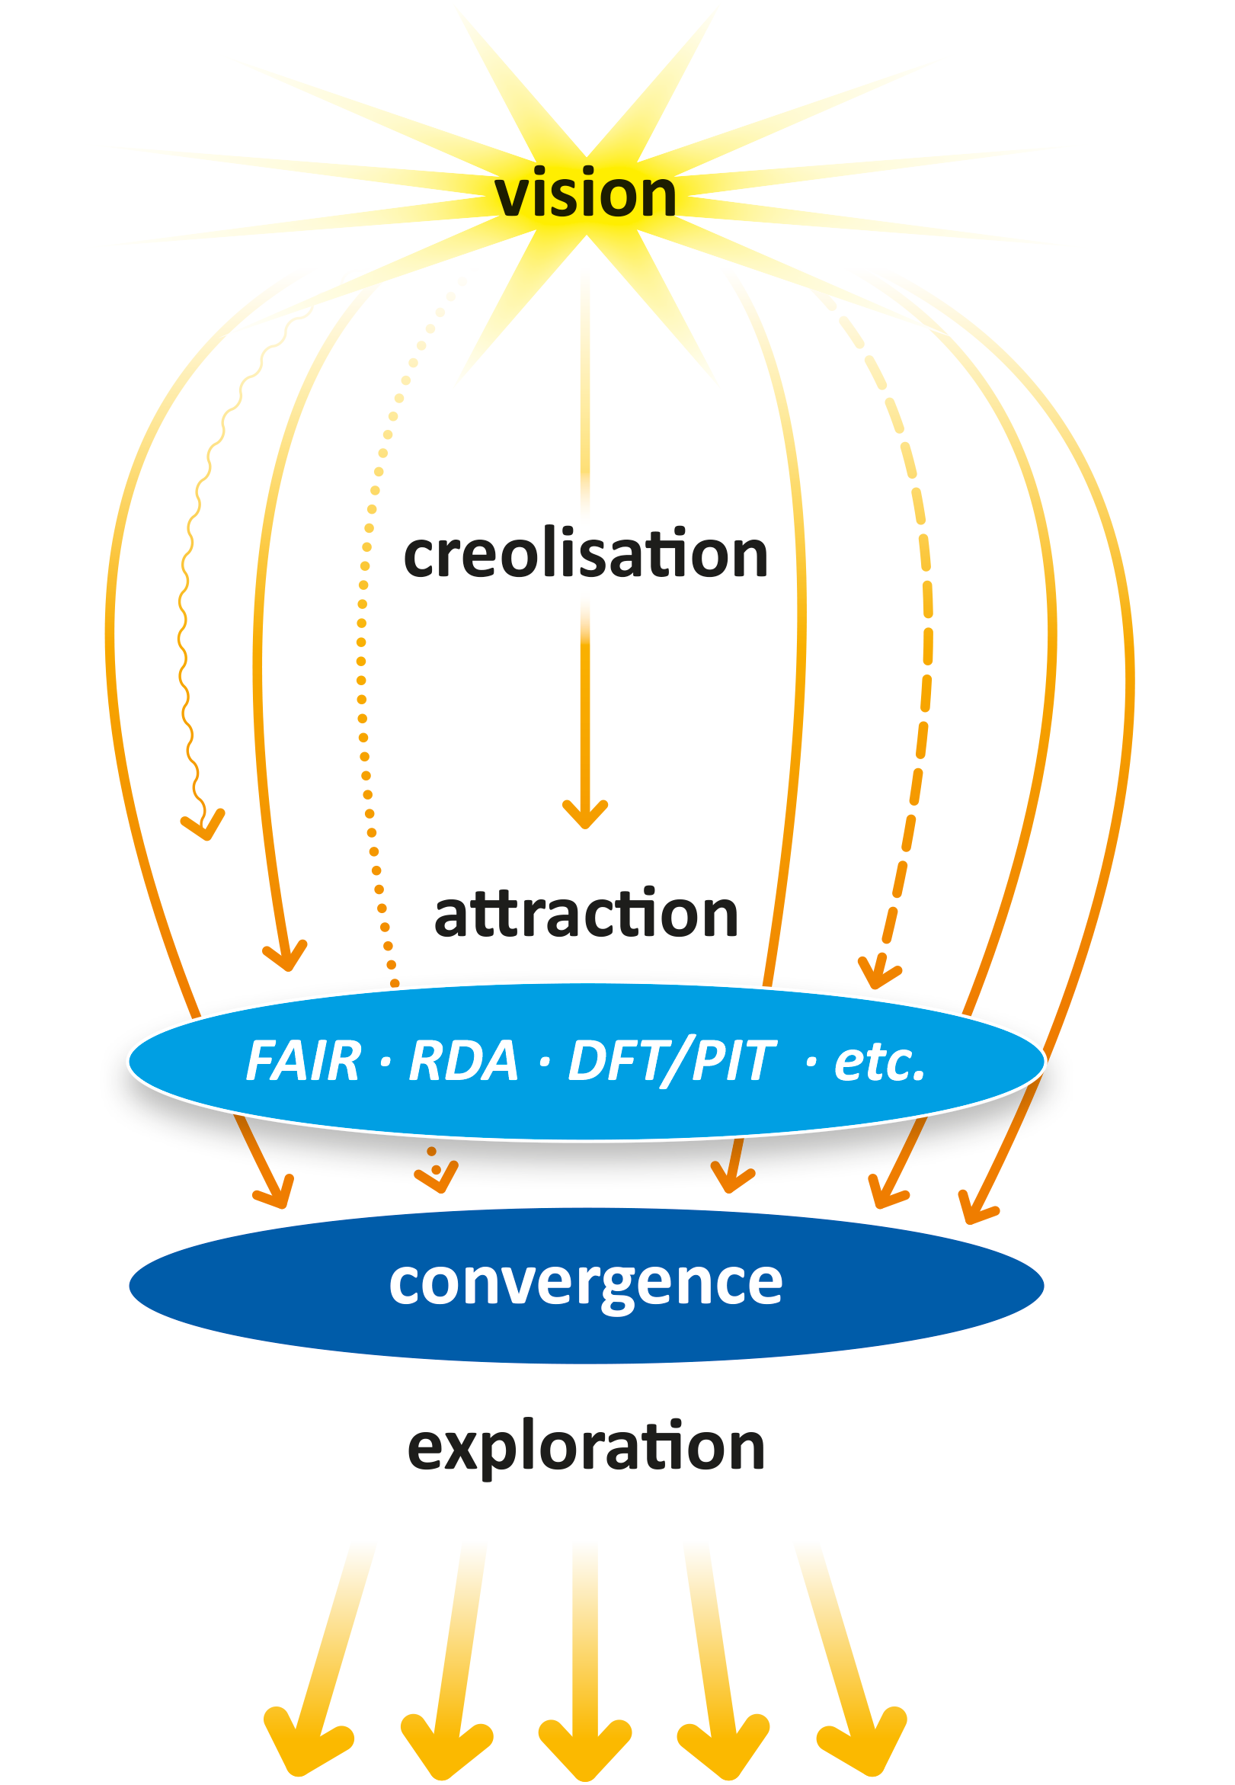
Creolisation in Data Domain
Recent Paper from Wittenburg & Strawn
Common Patterns in Revolutionary Infrastructures and Data
Right in the Creolisation Phase
so many brilliant minds
enormous solutions space – 1000 flowers ...
tested quite some approaches
Suffering from Fragmentation
Convergence is needed! ...
... but at which level?
... but how to organise the cross-
border process?
exploitation
CC BY-SA 4.0

Slide 5
Trends towards Convergence
Recent Paper from Wittenburg & Strawn
Common Patterns in Revolutionary Infrastructures and Data
Right in the Creolisation Phase
so many brilliant minds
enormous solutions space – 1000 flowers ...
tested quite some approaches
Convergence is needed! ...
... but at which level?
... but how to organise the cross-
border process?
Two main strands towards convergence:
FAIR Principles
FAIR Digital Objects
(they are complementary)
exploitation
CC BY-SA 4.0

Slide 6
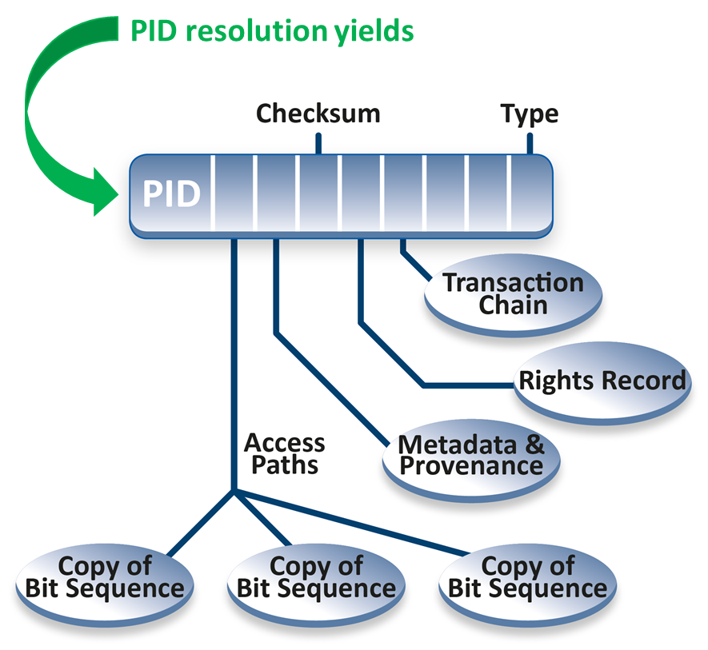
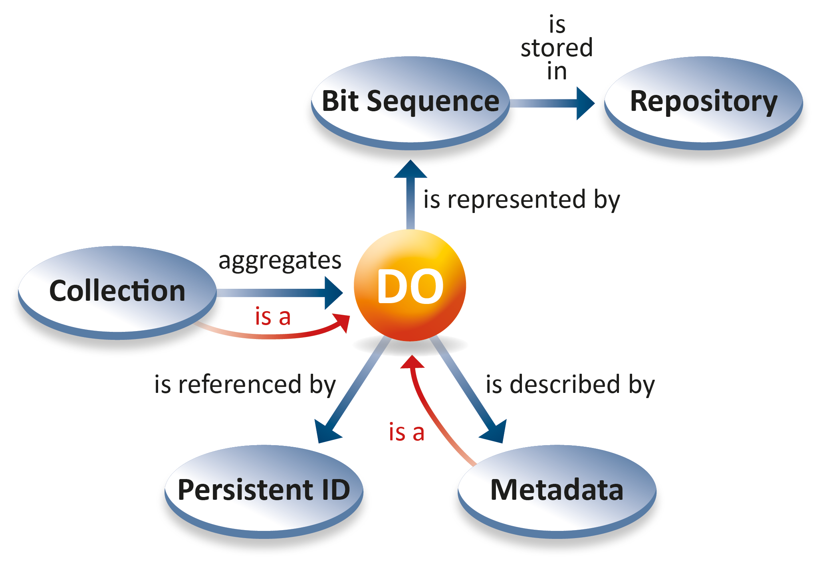
Digital Objects
early papers on DOs from Robert Kahn - an Internet Pioneer (1995, 2006)
taken up by RDA Data Foundation & Terminology in 2014: Core Model

Slide 7
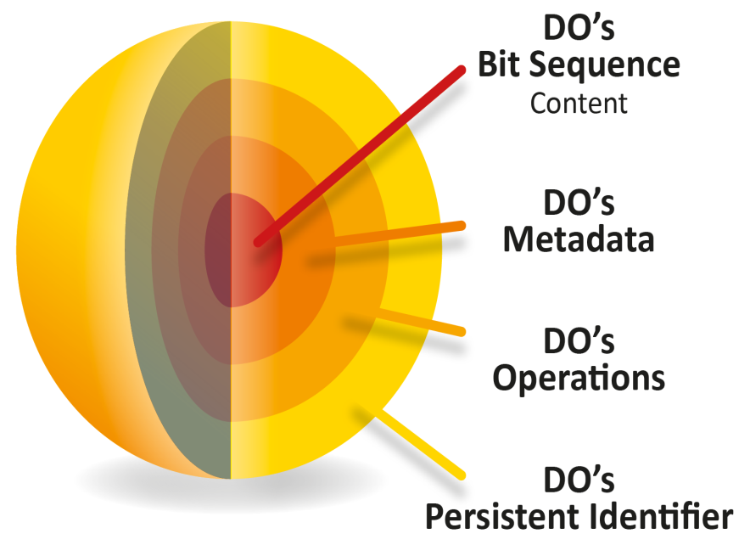
DOs reducing complexity
Resolving PIDs is key
(binding implementing basic FAIR)
DO Content arbitrary
(abstraction from details)
associating types with DOs
(way towards automation)
all must be machine-actionable!

Slide 8
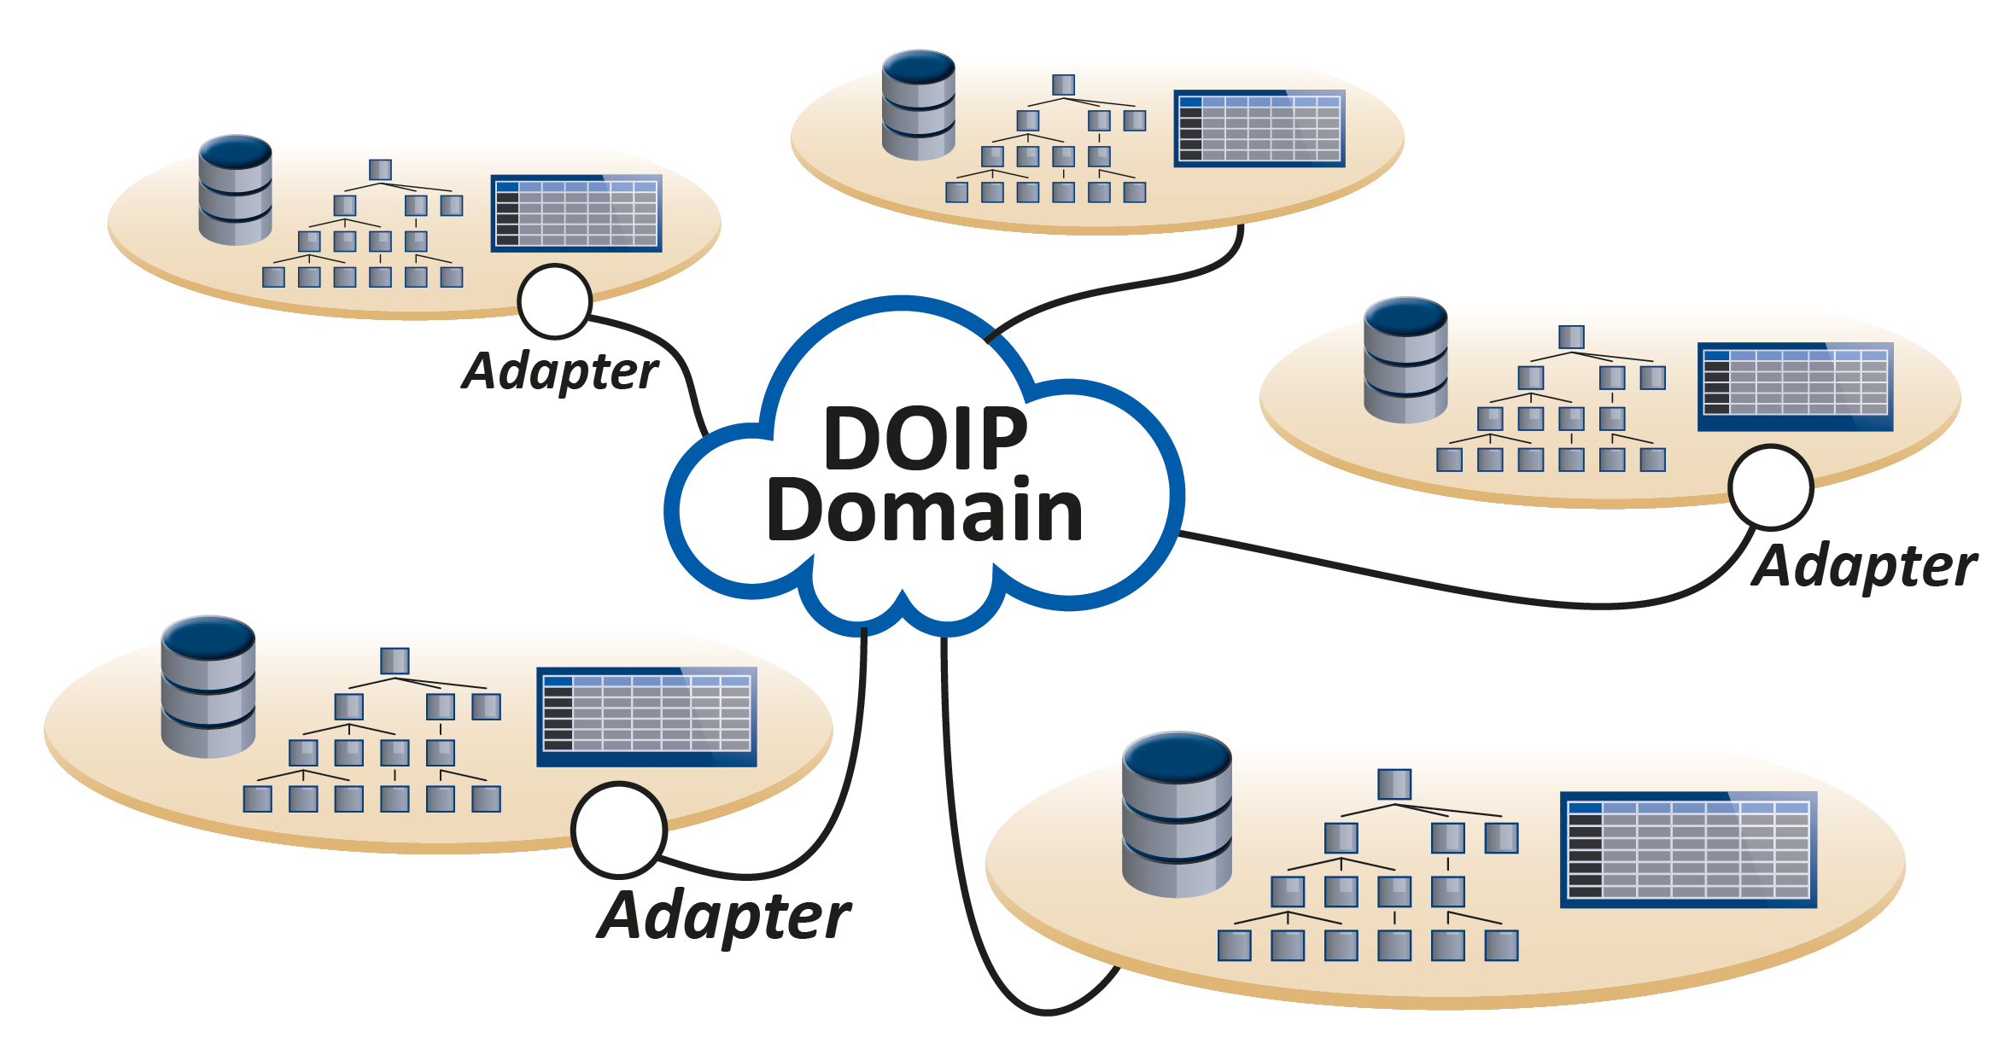
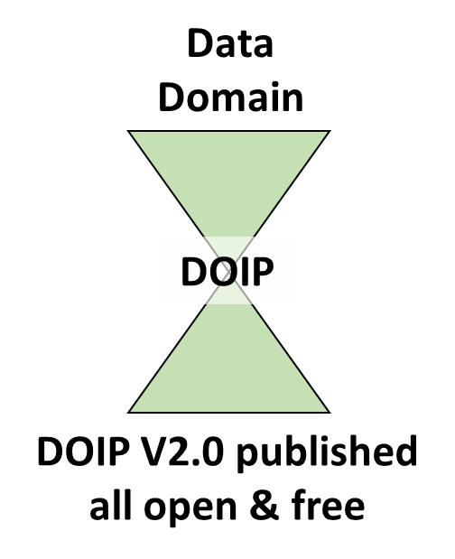
Protocol for Integration
Data Domain
DO Interface protocol (DOIP) could build bridges between all types of data organisations in the different repositories by providing a unified access to DOs
DOIP would create a universal layer of interoperability and facilitate working with data

Slide 9
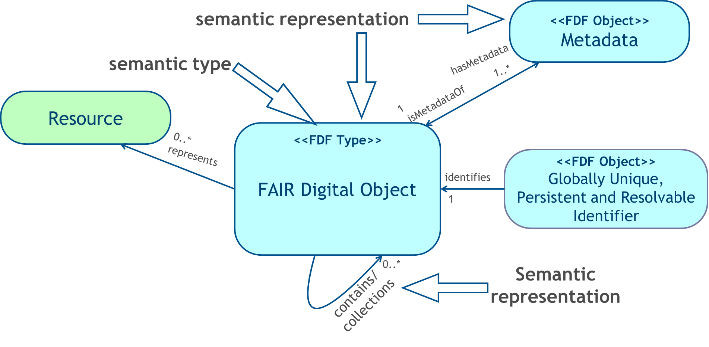
FAIR requires Semantic Explicitness
(in close collaboration with Luiz Bonino
and by borrowing mechanisms from LD)

Slide 10
FAIR DO and FAIR DO Framework
By adding explicit semantics DOs can be made fully FAIR
Thus → FAIR Digital Objects
There can be several implementations of the FDO concept
Therefore we talk about a FDO Framework defining constraints
FDOF will soon become available on
Github GEDE -> DO
https://github.com/GEDE-RDA-Europe/GEDE/tree/master/Digital-Objects

Slide 11
References
RDA DFT Core Model; http://hdl.handle.net/11304/5d760a3e-991d-11e5-9bb4-2b0aad496318
Wittenburg & Strawn: Common Patterns in Revolutionary Infrastructures and Data; http://doi.org/10.23728/b2share.4e8ac36c0dd343da81fd9e83e72805a0
Wittenburg, Strawn, Mons, et al.: Digital Objects as Drivers towards Convergence in Data Infrastructures; http://doi.org/10.23728/b2share.b605d85809ca45679b110719b6c6cb11
GEDE Workshop on DOs: http://doi.org/10.23728/b2share.0347cfc5bddb4124a4abadbcf180bef5
EC FAIR Implementation Report: https://doi.org/10.2777/1524
DOIP Specification: https://www.dona.net/sites/default/files/2018-11/DOIPv2Spec_1.pdf
Schultes & Wittenburg: GOing FAIR and DOing FAIR, (to come)
RDA GEDE DO Web-Site: https://rd-alliance.org/group/gede-group-european-data-experts-rda/wiki/gede-digital-object-topic-group
RDA GEDE Github: https://github.com/GEDE-RDA-Europe/GEDE

